Slide 1


MICROSOFT STUDIO MOVIE ANALYSIS
DATA ANALYSIS PROJECT

Slide 2

Experimental Design
Business Problem
2. Data Understanding
3. Data Preparation
4. Data Analysis
5. Conclusions and Recommendations
Experimental Design

Slide 3

Problem Statement
Microsoft recognizes the trend of major companies producing their own original video content and seeks to create their own Movie Studio. The task is to investigate the current performance of different film genres at the box office and translate the results into practical recommendations to guide their decision making on the types of films to produce.
Problem Statement

Slide 4
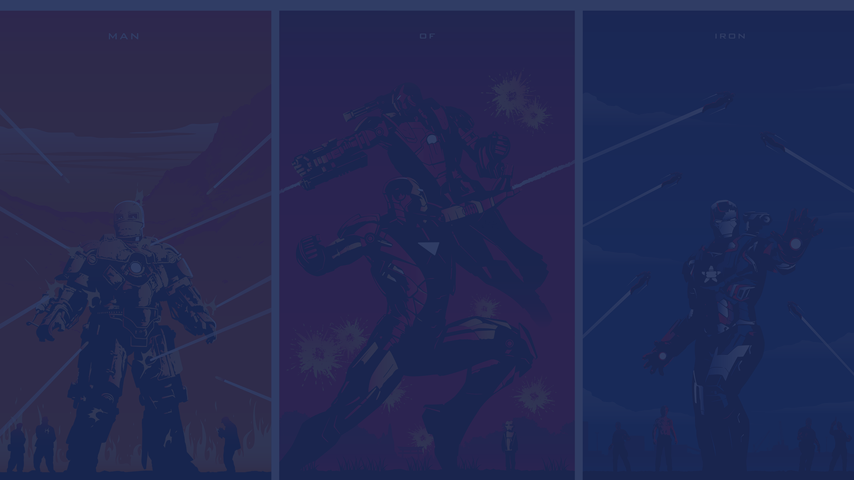
Analysis Objectives
1. Research current film trends and analyze box office success of various movie genres.
2. Identify the most profitable and popular movie genres in the market.
3. Develop a list of recommendations for Microsoft's new movie studio based on the research findings.
Analysis Objectives

Slide 5
DATA ANALYSIS

Slide 6
Data Preparation
The steps taken to prepare the data for analysis were:
Merging the datasets; movie_budgets, tmdb and title_basics.
Dropping the columns that are redundant and not required for the analysis.
Checking for and imputing null values.
Checking for duplicated entries and dropping them.
Converting the production_budget, domestic_gross and worldwide_gross columns into numeric columns.
Data Preparation

Slide 7
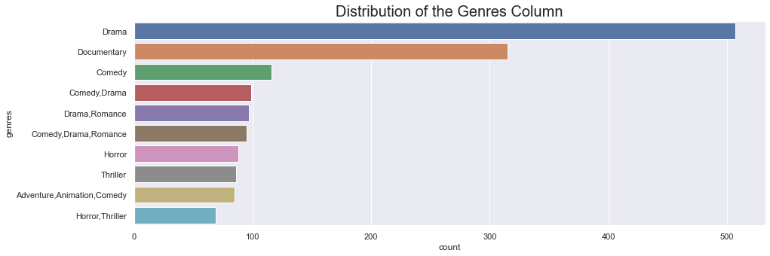
Top 10 Genres
Majority of the movies in the data belonged to the Drama genre.

Slide 8
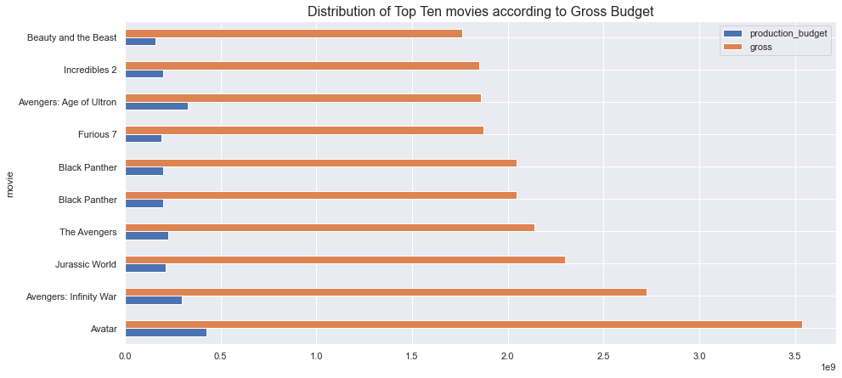
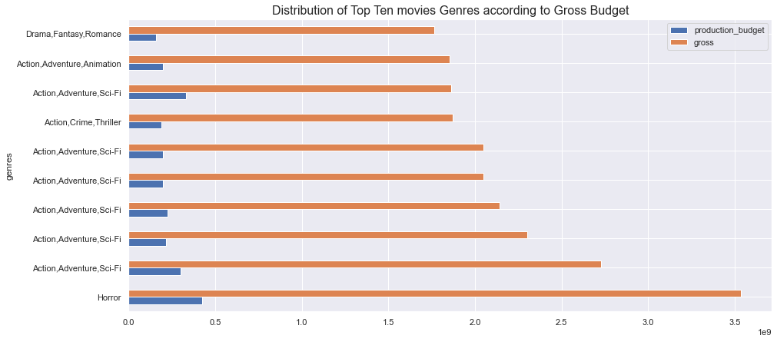
Top 10 Movies by the Gross Amount
Six of the ten top grossing movies belonged to the Action,Adventure and Sci-Fi Genre.

Slide 9
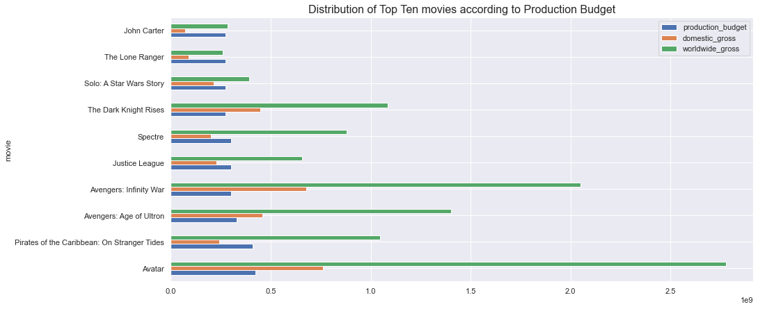
Top 10 Movies by the Production Budget

Slide 10

CONCLUSIONS & RECOMMENDATIONS

Slide 11
Conclusions
From the analysis, it was noted that, overall there is a strong positive correlation between the Production Budget and the Domestic and Worldwide Gross.
Overall movies in the Adventure Genre Outperformed movies in other Genres.
The Horror Genre grossed the highest amount in terms of both Domestic and Worldwide Gross. However it should be noted that the reason for this is due to the Avatar Movie, an outlier, which had significant success at the Box Office due to several reasons.
Conclusions

Slide 12
Recommendations
1. Microsoft's movie studio should be willing to invest significant capital into their movies, the ten top grossing movies had an average Production Budget of 244,560,000.
2. Movies in the Action,Adventure,Sci-Fi Genre seem to perform overall very well. Microsoft should invested in these Genres.
Recommendations

